Slide 1
TEMPO Ground Segment and Science Operations
Raid M. Suleiman, John C. Houck, John E. Davis, Lindsay P. Yatsuhashi, and Jean A. Fitzmaurice
August 19, 2025

Slide 2
Week in the life
Obs. Type | Tasks | Day
Non-Commanding | Monitor instrument (all the time) | Every day
 | Display trending telemetry points (TPs) (all the time) | Every day
Commanding | Weekly obs. planning meeting | Friday
 | IOC receives maneuver schedules and ephemeris | Monday
 | SPDC produces scan planning tables | Monday
 | IOC generates the command load | Monday
 | IOC validates the command load on the simulator | Tuesday
 | Command load is sent to Intelsat | Wednesday
 | Commands uploaded to the spacecraft | Wednesday
 | CSM starts | @02:45 UTC Thursday
 | Monitor instrument (all the time) | Every day
 | Display trending telemetry points (TPs) (all the time) | Every day
Special Obs. | Same as commanding, but requires more time for planning SPDC produces scan planning tables tailored to the special obs. | MUST receive request 2 weeks in advance 1 week planning
Contingency Ops. | Follow written procedures | Whenever it occurs
Notes:
The idea is that we have all day Thursday to look for any issues with the new CSM, which gives us time to prepare and upload a corrected one by Friday should the need arise. We don't anticipate this happening but I like the idea of being prepared for this.

Slide 3
Week in the life: Operations Schedule
Day | Tasks
Monday | Planning meeting to decide if normal or special observations
 | We get the maneuver schedules and ephemeris by 2:00 PM EST
 | The SPDC produces scan planning tables for the IOC
 | The IOC generates the command load
Tuesday | The IOC validates the command load on the simulator
Wednesday | The command load is sent to Intelsat
 | It gets uploaded to the spacecraft that evening
Thursday | The command load gets pushed to the instrument at 02:45 UTC. At that point, the new CSM takes over.
 | The solar calibration happens around 04:00 UTC
 | The first earth scan in the new CSM starts at roughly 11:00 UTC
 | We look for any issues in the new CSM
Friday | We continue to monitor
Notes:
The idea is that we have all day Thursday to look for any issues with the new CSM, which gives us time to prepare and upload a corrected one by Friday should the need arise. We don't anticipate this happening but I like the idea of being prepared for this.

Slide 4
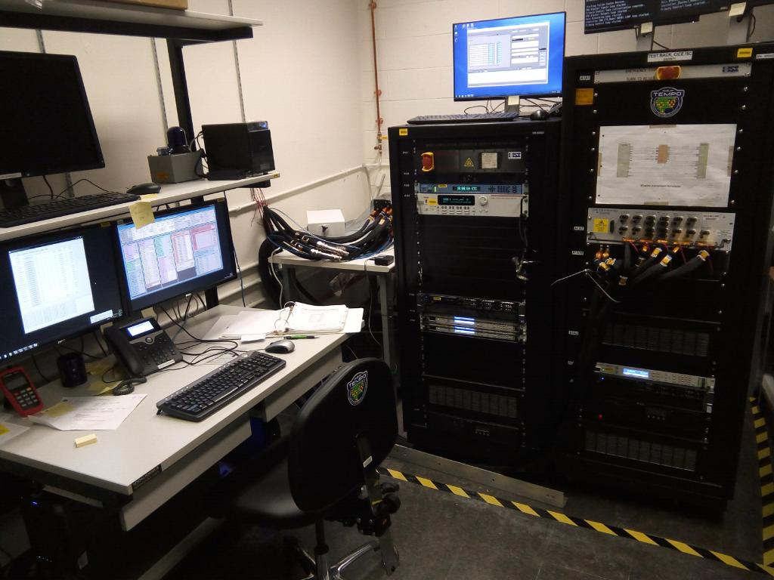
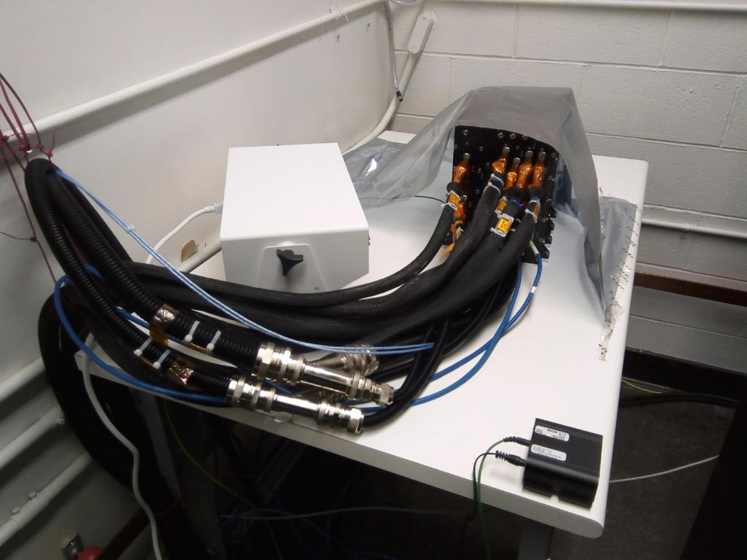
TEMPO Simulator
  The TEMPO instrument simulator is used to validate command blocks
  We have database of 1260 command blocks that have been validated on the simulator
  The command blocks perform East-to-West scans with varying durations from 6 minutes to 1 hour
Notes:
Instrument Simulator Console (ISC), Instrument Control Electronics (ICE) and the Bus Simulator Console (BSC),

Slide 5
Simulator Anomaly
On October 22, 2024, the simulator developed an issue associated with the MIL-STD-1553 bus. This issue is being tracked in Redmine #238
Since the first MIL-STD-1553 error, the simulator experienced the same error a number of other times, the latest on June 6, 2025.
BAE recommended we purchase a Bus Monitor to further diagnose and correct the issue. The Bus Monitor arrived on February 12, 2025
We are actively working with BAE to resolve the problem
  Logs were provided to BAE
We have validated no additional command blocks since October 22, 2024. Our command loads have relied upon our previously validated command blocks
  We have experienced no commanding errors using this approach.

Slide 6
Hourly and Optimized Scans

Slide 7
Commanding Summary
Commanding:
  294,931 successful commands executed by the instrument (excluding spacecraft generated IRU_BIASES commands)
  20 rejected commands (all during commissioning and all caused by a spacecraft bug affecting TBL_UPLOAD commands whose size fall on a 64-byte boundary)
We have had 10,597,114 radiance images
162 working diffuser images and 10 reference diffuser images
104,446 dark images
City light measurements – 3283 granules
  West & East Coast: 7 days
  Chicago and Houston: 4
  Full FOR coverage: 2 day
  Partial FOR coverage: 1 day
  Aurora (tilt FOR north)

Slide 8
Anomalies & Event Messages
SAFE Mode (none since January 24, 2024)
  September 8, 2023, due to an unscheduled maneuver by Intelsat that was not contained in the maneuver file (not related to the instrument).
  January 24, 2024, due to change in IS40e pointing, caused by the failure of the GPSR1 (not related to the instrument).
Scan mirror stopped advancing midway through scan: 11 times (2023-10-30, 2023-11-30, 2024-02-07, 2024-03-31, 2024-05-13, 2024-05-31, 2024-07-03, 2024-09-23, 2025-01-07, 2025-03-25, and 2025-04-07).
UT_INVALID_TIME_CODE (46 times): This event is posted when a Time Code Update is received from the S/C, but the TCU message is invalid - it contains an invalid time value.
CAL Wheel closed and CSM was stopped because of a GPSR issue: 2024-01-24 (resulting in SAFE mode), 2024-07-24, 2024-10-25, 2025-02-06, 2025-02-07, 2025-07-22, and 2025-07-31.
The anomalies did not affect operations or the quality of the science, except for when the instrument was in SAFE Mode.

Slide 9
Green Paper Potential Observations
The green Paper is available here https://tempo.si.edu/documents/TEMPO-Green-Paper-Mar2025-clean.pdf
Covered by hourly scans
  Foliage studies
  Air pollution from oil and gas fields
  Ship tracks, drilling platform plumes, and other concentrated sources
  Regional and local transport of pollutants
  Transboundary pollution gradients
  Tracking short-term public health outcomes using high-resolution TEMPO data
  Observing NO2 pollution inequality in North American cities
  Examining impacts of warehouse density on Inland Empire Air Quality
  Spatial inhomogeneities of NO2 and HCHO over urban areas
  Lightning Nox
  Cloud field correlation with pollution
  TEMPO Validation during the May-June 2024 Satellite Coastal and Oceanic Atmospheric Pollution Experiment 2 (SCOAPE-II) Gulf of Mexico Cruise
See TEMPO Special Observations Poster
We encourage you to submit observation request from the Green Paper

Slide 10
Summary
We continue to work with BAE to troubleshoot the 1553 bus issue and bring back the simulator into operational state.
Our command loads have relied upon our previously validated command blocks, and we have experienced no commanding errors using this approach.
We are ready and capable of performing special observations
  We require a minimum 2-week notification (form is available at the Early Adopters website)
  Complexity of the scan pattern coupled with the unavailability of the Simulator
We encourage the science team to submit observation requests from the Green Paper.

Slide 12
Hourly and Optimized Scans

